Slide 1
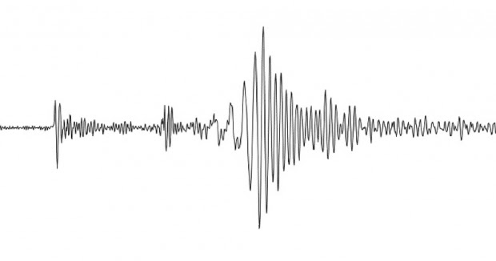
It’s All My Fault!
California Earthquakes: Lesson 4
This Photo by Unknown Author is licensed under CC BY-NC-ND

Slide 2
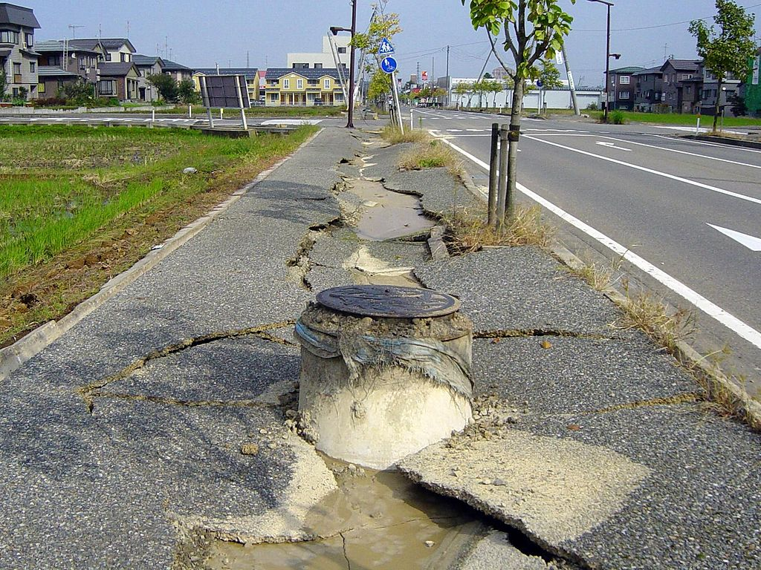
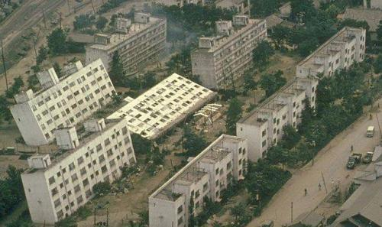
What happened here?
This Photo by Unknown Author is licensed under CC BY-SA
This Photo by Unknown Author is licensed under CC BY-SA

Slide 3
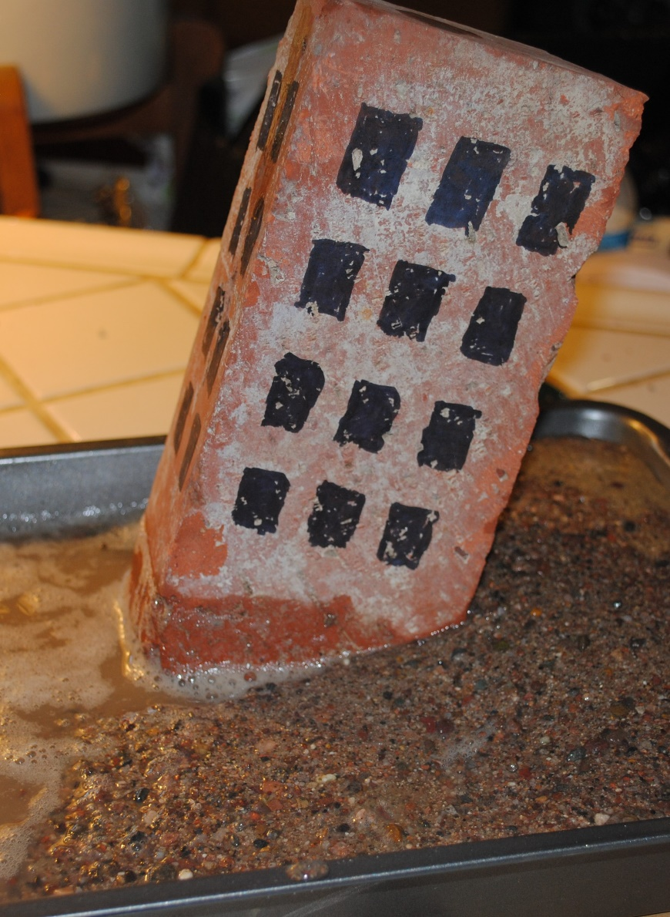
Shaky Sediments! Use a metal pan, add water to the bottom. Fill the rest with sand. Place a brick (your building) in the sand, then tap with a mallet. See what happens!
To see a video of this activity click here:
https://www.youtube.com/watch?v=Kkgt-cPjBwA

Slide 4
Liquefaction can occur after an earthquake.
Liquefaction occurs when saturated sandy soils are shaken during an earthquake. The water pressure increases until the sand grains separate, and the soil turns into a liquid-like material.

Slide 5
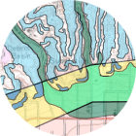
You can use an online map to look at liquefaction areas in California!
Use the layers button and select the liquefaction map.
https://maps.conservation.ca.gov/cgs/EQZApp/App/

Slide 6
Liquefaction Explanation
Write two sentences that explains how liquefaction works by including the following information in your explanation:
What causes liquefaction?
What is the effect of liquefaction?
Why does liquefaction occur?

Slide 7
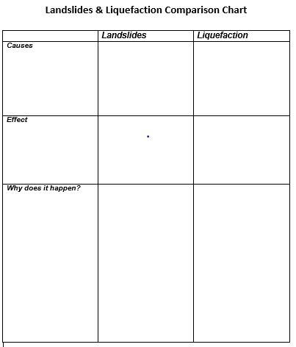
Landslide & Liquefaction Comparison Chart
Compare the causes and effects between landslides and liquefaction.

Slide 8
conservation.ca.gov
maps.conservation.ca.gov

